Slide 1
DSI + Capstone
Part 2
By Emma Corbino

Slide 2
Capstone Project DengAI: Predicting Disease Spread
Dengue fever is a mosquito-borne disease that occurs in tropical and sub-tropical parts of the world.
Because it is carried by mosquitoes, the transmission dynamics of dengue are related to climate variables such as temperature and precipitation.
Using environmental data collected by various U.S. Federal Government agencies—from the Centers for Disease Control and Prevention to the National Oceanic and Atmospheric Administration in the U.S. Department of Commerce—can you predict the number of dengue fever cases reported.
This is sponsored by DrivenData.org and the information collected will aid in helping predict outbreaks.

Slide 3
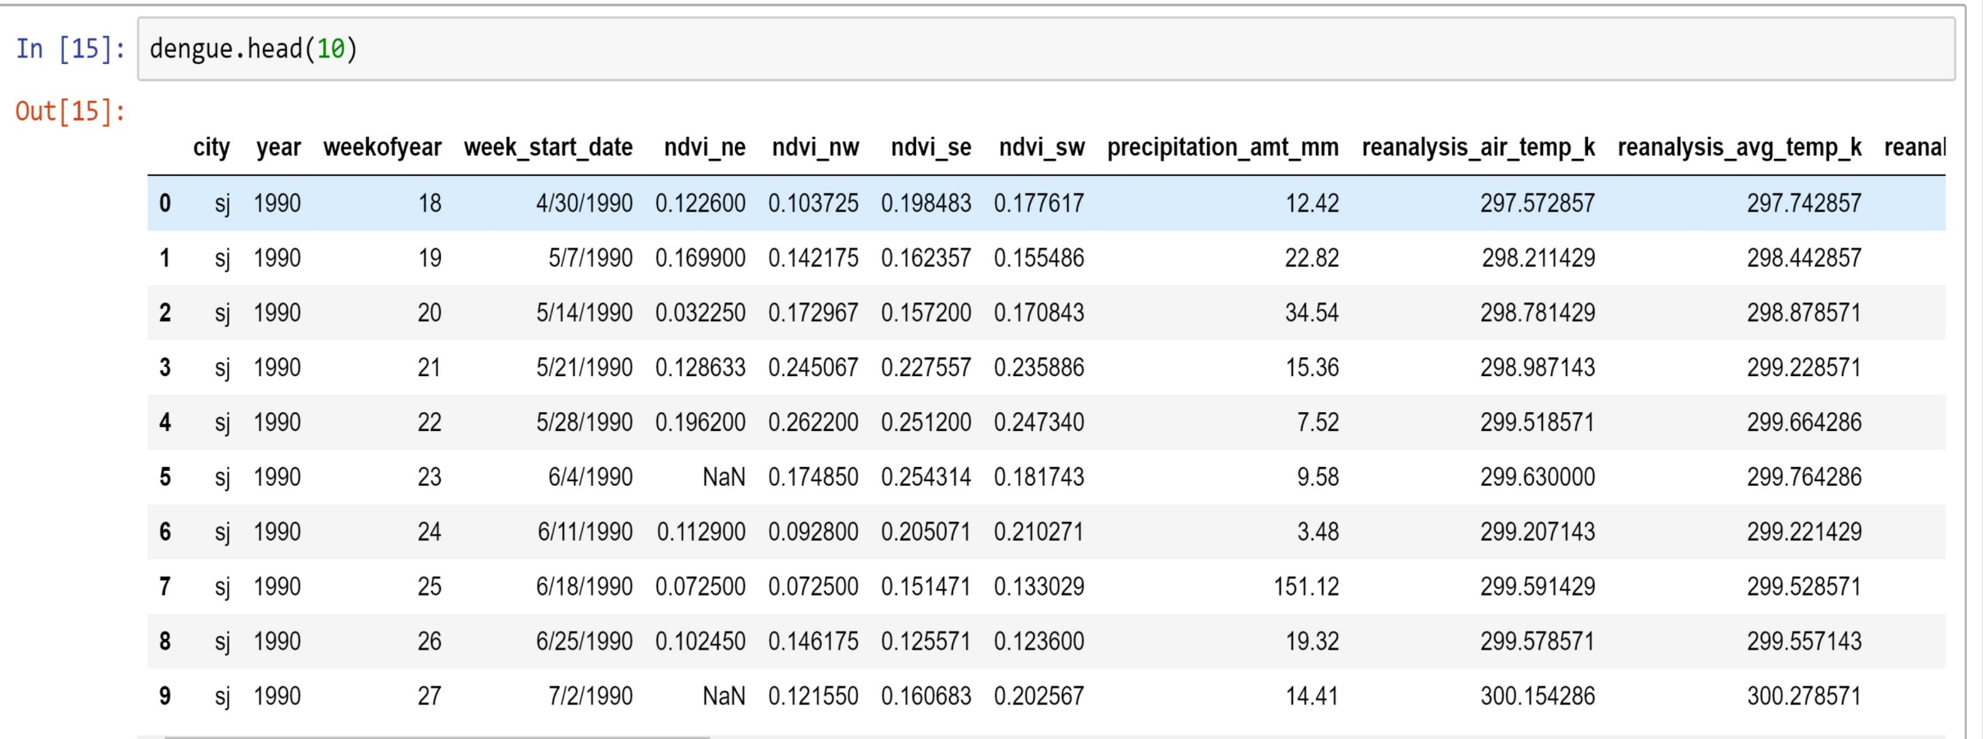
Exploratory Data Analysis

Slide 4
Initial Analysis Concerns
Null values have to be either filled in or dropped
Multiple rows have no data.
Mismatched measurement scaling ie temperature, weights
Research into climate and effect on region
More research into data dictionary

Slide 5
Preprocessing and Feature Engineering
Preprocessing
Feature Engineering
Features need to be scaled
Imputing if necessary
May make new feature columns depending on research ie precipitation amounts, temperature fluctuations, investigate correlation with temperature and precipitation

Slide 6
Modeling
Linear Regression – for baseline
Lasso to help determine which features are required and aid in regularization of data.
Support Vector Machine and/or Gradient Boosting Regressor.
Both are powerful modeling techniques that in conjunction with the tuning of hyperparamters of Grid Search will result in positive mean absolute error results.

